Slide 1
Capstone Project - Car accident severity (Week 2)
Notes:
This presentation demonstrates the new capabilities of PowerPoint and it is best viewed in Slide Show. These slides are designed to give you great ideas for the presentations you’ll create in PowerPoint 2010!
For more sample templates, click the File tab, and then on the New tab, click Sample Templates.

Slide 2
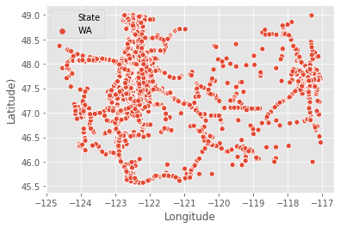
Background and Problem
Road crash fatalities and disabilities recognised as a major public health issue.
Accident visualization - Washington
~ 1.35 million people die and 30-50 million suffer non-fatal injuries in every year globally.
Road accident data for Washington state has been analyzed.
Machine learning techniques have been used on road accident data for King county.
The built model could be used for real time accident prediction.

Slide 3

Data acquisition and cleaning
The traffic collision dataset for 49 states of US was downloaded from Kaggle website (2016 to 2020)¹.
The raw dataset consists of 3513617 rows and 49 columns.
Data cleaning was performed.
34 features were selected for the improved accuracy of the prediction.
1. https://www.kaggle.com/sobhanmoosavi/us-accidents

Slide 4
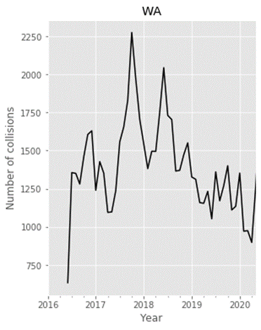
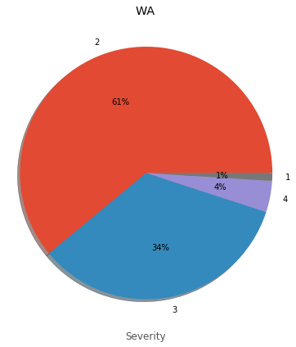
Exploratory data analysis
Number of collisions per month
Severity of an accident
Most of the accidents are in the severity level 2.

Slide 5
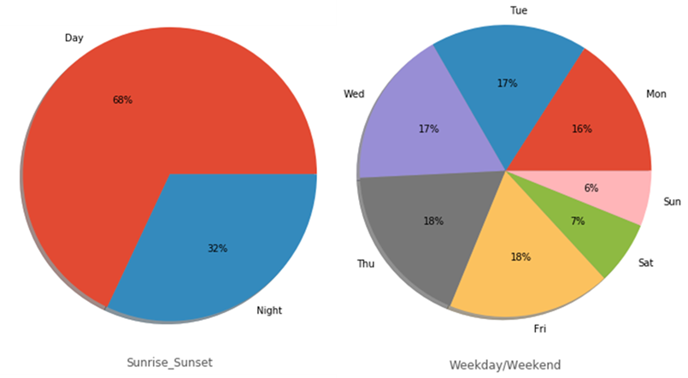
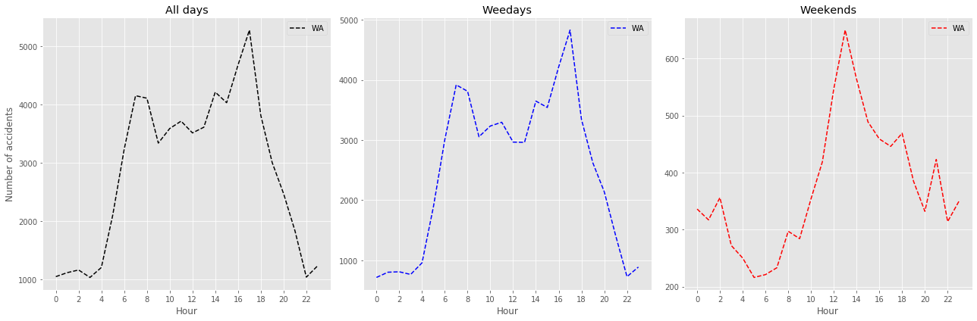
Exploratory data analysis
Day vs. night and days of a week
A higher rate of accidents observed during daytime.
More accidents are reported during weekdays than weekends.

Slide 6
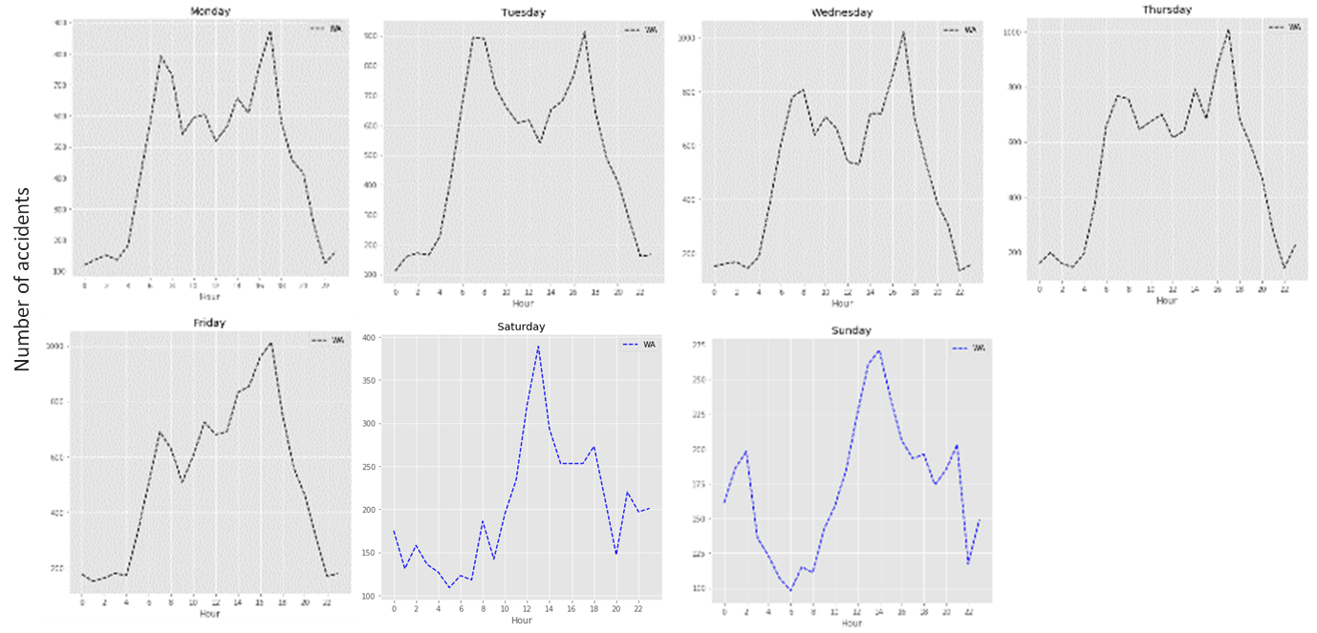
Exploratory data analysis
Hourly distribution of accidents
It is not recommended to travel around 7-8 am and 4-5pm on weekdays.
Similarly, early afternoon is not recommended for weekends.

Slide 7
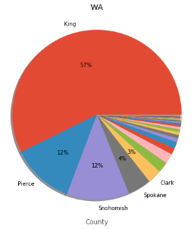
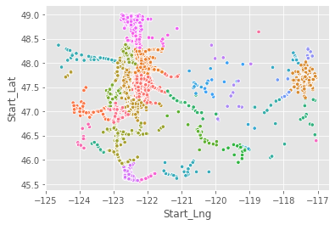
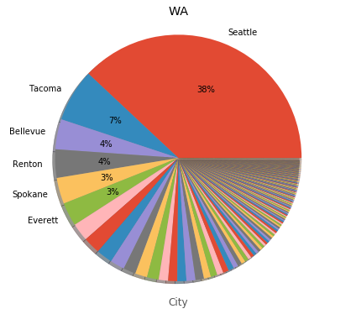
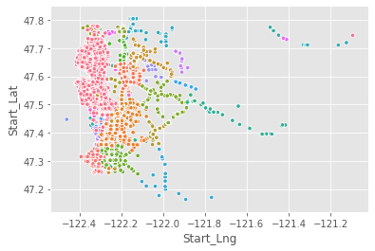
Exploratory data analysis
Collisions by county
Highest number of traffic collisions are reported from King county.
Collisions by city
Seattle is far ahead compared to other cities.

Slide 8
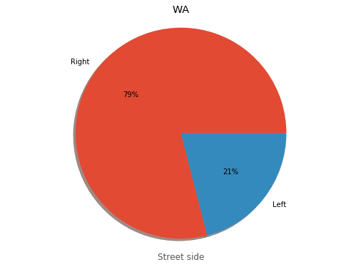
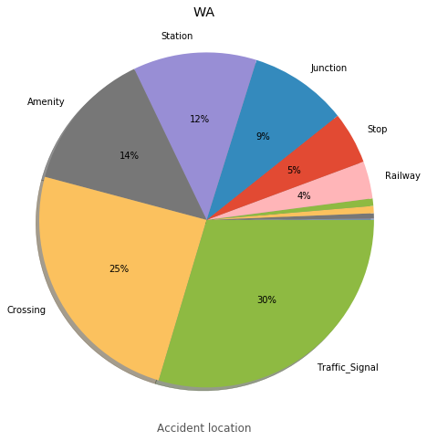
Exploratory data analysis
Percentage distribution by street side and location
Majority of the accidents occurred at the right side of the street.
30% of accidents are occurring at traffic signal, followed by crossing (25%).

Slide 9
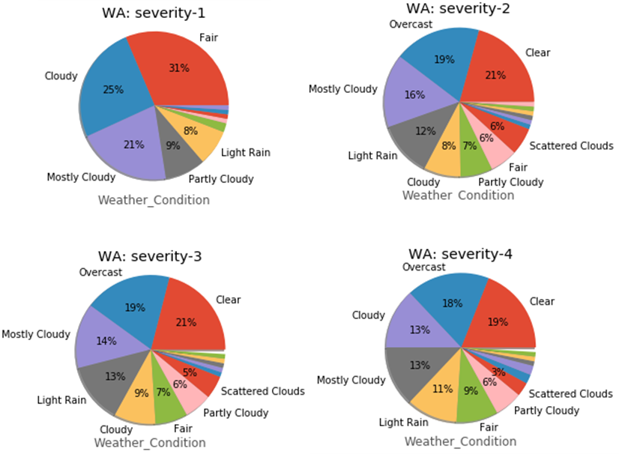
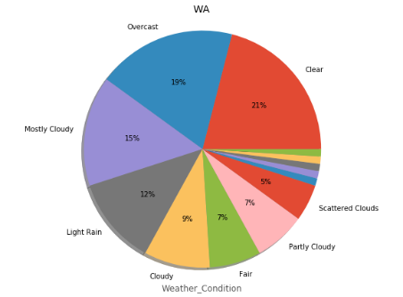
Exploratory data analysis
Weather conditions and severity
5 topmost weather conditions for accidents are clear, overcast, mostly cloudy, light rain, and cloudy.
Overcast, mostly cloudy and light rain are realistic factors for accidents.

Slide 10
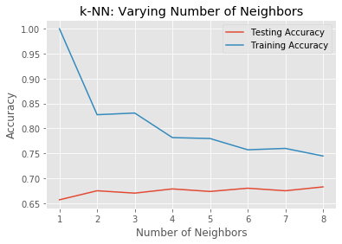
Machine learning algorithms and feature engineering
Out of 49, 34 features were selected based on their impact on accidents.
feature_lst=['Source','TMC','Severity','Start_Lng','Start_Lat','Distance(mi)','Side','City','County','State','Timezone','Temperature(F)','Humidity(%)','Pressure(in)','Visibility(mi)','Wind_Direction','Weather_Condition','Amenity','Bump','Crossing','Give_Way','Junction','No_Exit','Railway','Roundabout','Station','Stop','Traffic_Calming','Traffic_Signal','Turning_Loop','Sunrise_Sunset','Hour','Weekday', 'Time_Duration(min)']
Supervised machine learning algorithms
Logistic Regression
K-Nearest Neighbors (KNN)
Decision Tree
Random Forest Classification

Slide 11
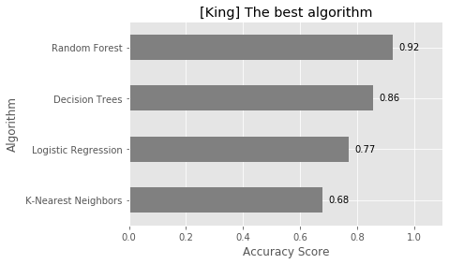
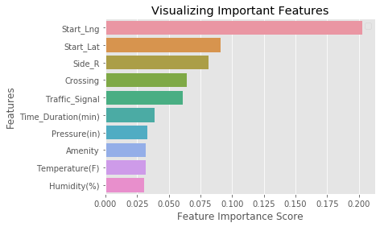
Machine learning algorithms
Random Forest classification shows the highest accuracy with a score of 0.92.
KNN shows the least accuracy (0.68).
Top ten features for prediction of accident severity for King county was extracted using Random Forest classification model.

Slide 12
Conclusion
Traffic collision data for WA state has been analyzed.
Factors which could lead to road crash fatalities and disabilities were identified and listed.
Machine learning algorithms were applied to predict the accident severity for King county and Random Forest classification shows the highest accuracy .
There is a room for improvement for accuracy of the models .
A full weather data could give a more realistic picture and also increase the accuracy of the models.

Slide 13
Acknowledgment
Moosavi, Sobhan, Mohammad Hossein Samavatian, Srinivasan Parthasarathy, and Rajiv Ramnath. “A Countrywide Traffic Accident Dataset.”, 2019.
Moosavi, Sobhan, Mohammad Hossein Samavatian, Srinivasan Parthasarathy, Radu Teodorescu, and Rajiv Ramnath. "Accident Risk Prediction based on Heterogeneous Sparse Data: New Dataset and Insights." In proceedings of the 27th ACM SIGSPATIAL International Conference on Advances in Geographic Information Systems, ACM, 2019.

